Slide 1
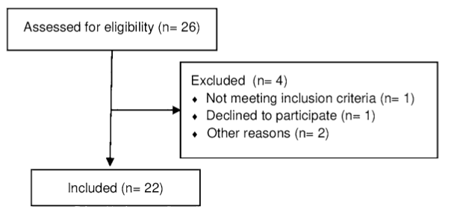
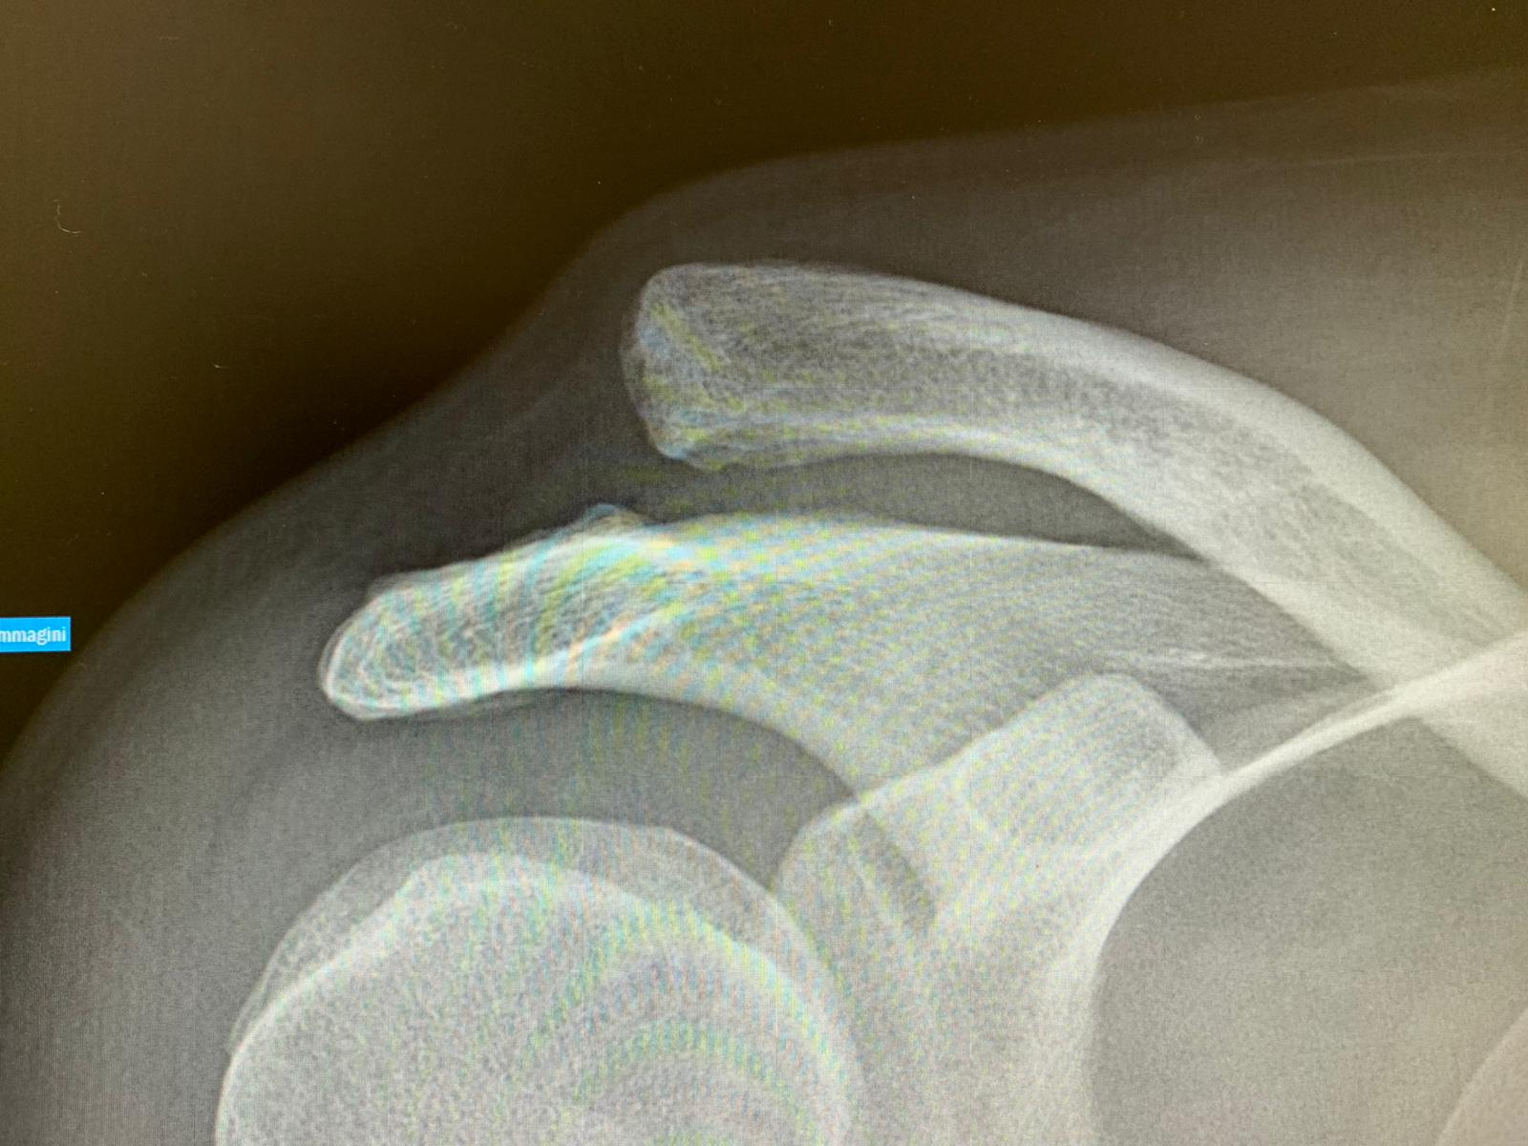
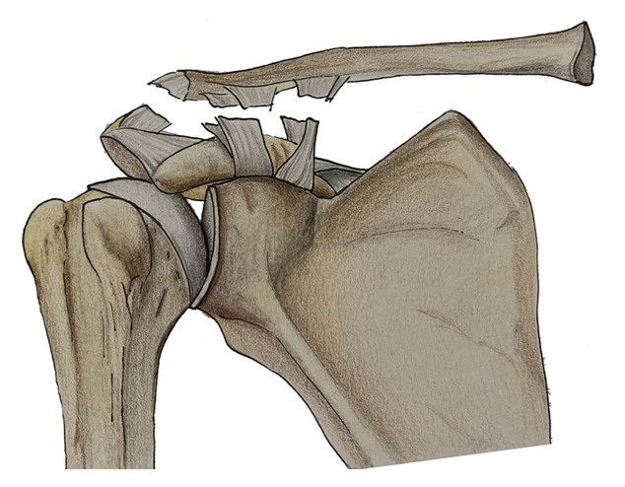
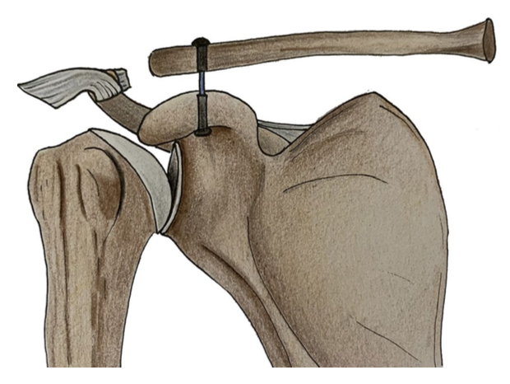
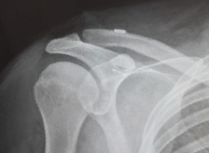
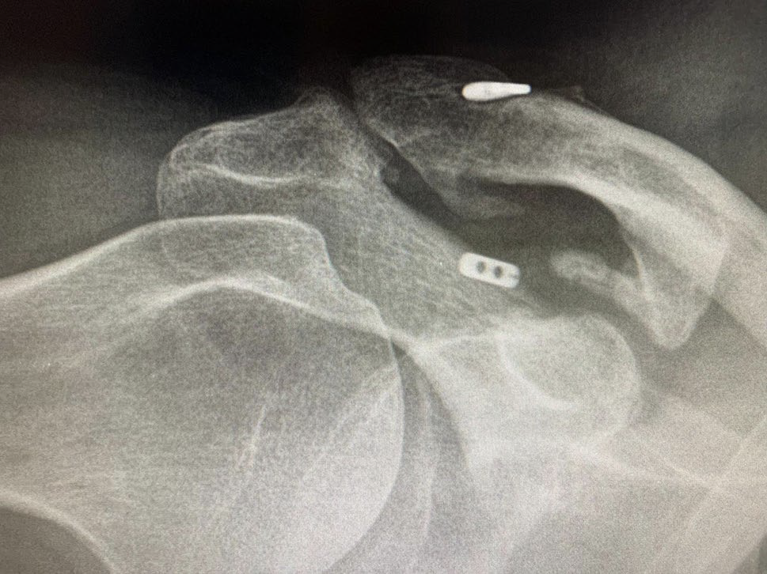
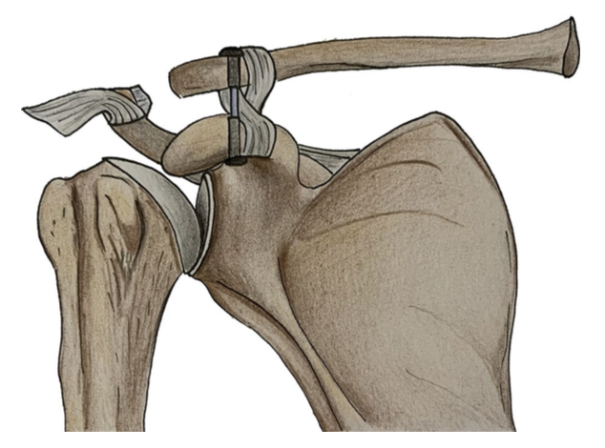
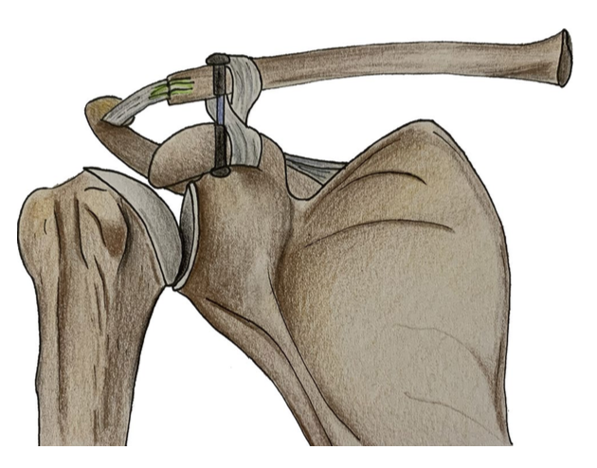
EP21.20
Hybrid coracoclavicular and acromioclavicular reconstruction in chronic acromioclavicular joint dislocations yields good functional and radiographic results
Simone Cerciello^{1,2}, Fabrizio Mocini^{1,2}, Lorenzo Proietti ^{1,2}, Gianluca Ciolli^{1,2}, Dario Candura¹, Vincenzo Brancaccio¹, Katia Corona³
¹Policlinico A. Gemelli, Rome, Italy; ²Casa di cura Villa Betania, Rome, Italy; ³Department of Medicine and Health Sciences “Vincenzo Tiberio”, Campobasso, Italy; ⁴Fondren Orthopaedic Group, Houston, United States.
INTRODUCTION
Optimal treatment of chronic unstable acromioclavicular (AC) joint dislocations (type III-V according the Rockwood classification) is still debated.
Anatomic coracoclavicular (CC) reconstruction is a reliable option in terms of two-dimensional radiographic reduction, clinical outcomes, and return to sports, but there remain concerns regarding anterior-posterior stability of the AC joint with CC ligament reconstruction alone.
The aim of the present study was to describe the mid-term results of a new hybrid technique with CC and AC ligament reconstruction for chronic AC joint dislocations.
RESULTS
Demographics
METHODS
Twenty-two patients surgically treated for chronic AC joint dislocations (grade 3 to 5) were retrospectively reviewed.
All patients were assessed before surgery and at final follow-up with the Constant-Murley score (CMS) and the American Shoulder and Elbow Surgeons (ASES) score.
The CC vertical distance (CCD) and the CCD ratio (affected side compared to unaffected side) were measured on Zanca radiographs preoperatively, at 6 months postop and at final follow-up.
The same surgical technique consisting in a primary fixation with a suspensory system, coracoclavicular ligaments reconstruction with a double loop of autologous gracilis and acromioclavicular ligaments reconstruction with autologous coracoacromial ligament was performed in all cases.
Twenty-two shoulders in 22 patients (19 males and 3 females) were evaluated with a mean age of 34.4 ± 9 years at the time of surgery.
The mean interval between the injury and surgery was 53.4 ± 36.7 days.
The mean duration of postoperative follow-up was 49.9 ± 11.8 months.
According to the Rockwood classification, there were 5 (22.6%) type-III and 17 (77.2%) type-V dislocations.
Mean preoperative ASES and CMS were 54.4 ± 7.6 and 64.6 ± 7.2, respectively.
They improved to 91.8 ± 2.3 (p = 0.0001) and 95.2 ± 3.1 (p = 0.0001), respectively at final FU.
Clinical and radiolgical
SURGICAL TECHNIQUE
Fig.1
The mean preoperative CCD was 22.4 ± 3.2 mm while the mean CCD ratio was 2.1 ± 0.1.
At final FU, the mean CCD was 11.9 ± 1.4 mm (p = 0.002) and the mean CCD ratio was 1.1 ± 0.1 (p = 0.009).
No recurrence of instability was observed although button cutout was observed in 1 patient
One patient developed a local infection and four patients referred some shoulder discomfort.
Heterotopic ossifications were observed in three patients.
Fig.1
The CA ligament is detached from the lateral aspect of the coracoid and prepared as a The undersurface of the coracoid is inspected
Fig.2
Fig.2 Two 4-mm tunnels in the clavicle and in the coracoid are drilled and AC joint is reduced under direct visualization using the Tightrope system.
CONCLUSIONS
The optimal treatment of chronic high-grade AC joint dislocations requires superior-inferior and anterior-posterior stability to ensure good clinical outcomes and return to overhead activities or sports.
The present hybrid technique of AC and CC ligaments reconstruction showed good clinical and radiographic results and is a reliable an alternative to other reported techniques.
Fig.3
Fig.3 The free ends of the gracilis tendon are passed around the clavicle and coracoid in a figure-of-8 configuration, pulled together and then sutured to the underlying loop with #2 Vicryl stitches.
REFERENCES
1. Beitzel K, Cote MP, Apostolakos J, Solovyova O, Judson CH, Ziegler CG, Edgar CM, Imho AB, Arciero RA, Mazzocca AD (2013) Current concepts in the treatment of acromioclavicular joint dislocations. Arthroscopy 29:387–397
2. Pallis M, Cameron KL, Svoboda SJ, Owens BD (2012) Epidemiology of acromioclavicular joint injury in young athletes. Am J Sports Med 40:2072–2077
3. Rothenberg A, Gasbarro G, Chlebeck J, Lin A (2017) The Coracoacromial Ligament: anatomy, follow-up function, and clinical significance. Orthop J Sports Med 5(4):2325967117703398
4. Skjaker SA, Enger M, Engebretsen L, Brox JI, Bøe B (2020) Young men in sports are at highest risk of acromioclavicular joint injuries: a prospective cohort study. Knee Surg Sports Traumatol Arthrosc 29(7):2039–2045
5. Frank RM, Cotter EJ, Leroux TS, Romeo AA (2019) Acromioclavicular Joint Injuries: evidence-based treatment. J Am Acad Orthop Surg 27(17):775–778
6. Zhu Y, Hsueh P, Zeng B, Chai Y, Zhang C, Chen Y, Wang Y, Maimaitiaili T (2018) A prospective study of coracoclavicular ligament reconstruction with autogenous peroneus longus tendon for acromioclavicular joint dislocations. J Shoulder Elbow Surg 27(6):178–188
7. Rosso C, Martetschläger F, Saccomanno MF, Voss A, Lacheta L, Beitzel K, Milano G (2021) High degree of consensus achieved regarding diagnosis and treatment of acromioclavicular joint instability among ESA-ESSKA members. Knee Surg Sports Traumatol Arthrosc 29(7):2325–2332
8. Jones HP, Lemos MJ, Schepsis AA (2001) Salvage of failed acromioclavicular joint reconstruction using autogenous semitendinosus tendon from the knee. Surgical technique and case report. Am J Sports Med 29(2):234–237
9. Carofino BC, Mazzocca AD (2010) The anatomic coracoclavicular ligament reconstruction: surgical technique and indications. J Shoulder Elbow Surg 19:37–46
10. Kibler WB, Sciascia AD, Morris BJ, Dome D (2017) Treatment of symptomatic acromioclavicular joint instability by a docking technique: clinical indications, surgical technique, and outcomes. Arthroscopy 33(4):696–708
Fig.4
Fig.4 The sutures from the CA ligament are passed into the small tunnels through the distal clavicle and tied together.

